Slide 1
Charlie’s 2024 Spring Presentation
Written By: Charlie
Edited By: Charlie
Drafted By: Charlie

Slide 2
What Was your favorite memory
What did I learn in Communication
What did I learn in Core
How to effectively self advocate
How to seem more approachable
How to Resolve Conflict
Well, this is kinda hard to choose. I probably would have to go with just the time I’ve spent with people I’ve started to think of as friends.
The best part is, some of them are actually similar enough to me that I feel like we can understand each other, and at least somewhat talk about more in-depth topics!

Slide 3
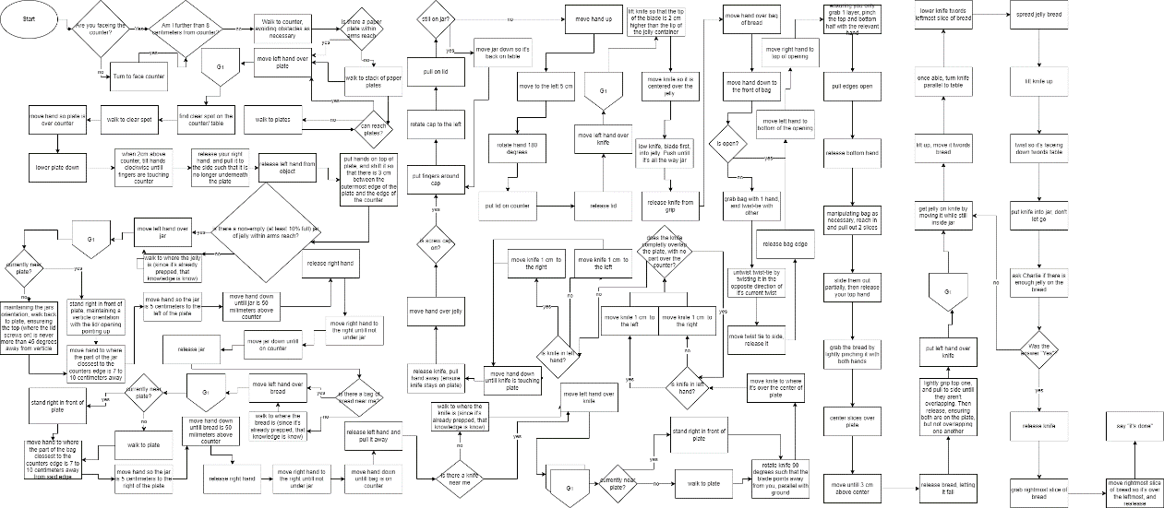
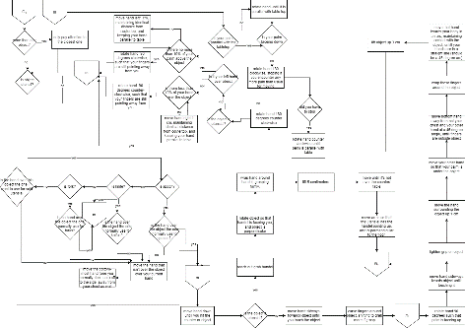
Tech
Tech & Photography
I
Learn
:
What
Did
Oops, minor mistype
In Tech I:
Made a “Hello World” program
Modified said program to accept names
Learned how to use flowcharts (and “slightly” over complicate them)
Meanwhile, in Photograph I :
Learned more about the very beginnings of photography as we consider it
Learned about Photo Manipulation
Game Desing- What Did I Learn
Oh, Right, Game Design goes here
I feel like I’m forgetting something…
In game design theory I learned the concepts behind designing games, and writing game reviews.
The part I consider most important for what I learned are the “frameworks”

Slide 4
The Start
The Ending
The End Of The Beginning
The Beginning Of The End
The Ending
The End Of The End
Or, am I done here… we may never know!
So, I’m done here. The End.

